Slide 1



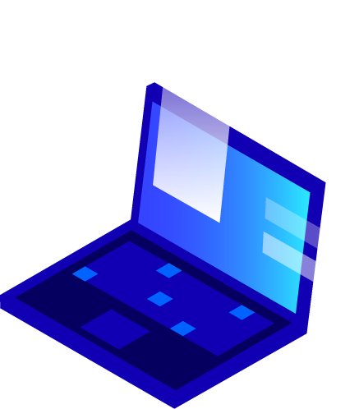


Kushal(1818559) Bhuvan Sharma(1818547) Mentor – Er. Anupriya Kaushal
Department of Computer Science & Engineering
IKG PUNJAB TECHNICAL UNIVERSITY MAIN CAMPUS KAPURTHALA
VOICE CONTROLLED EMAIL

Slide 2
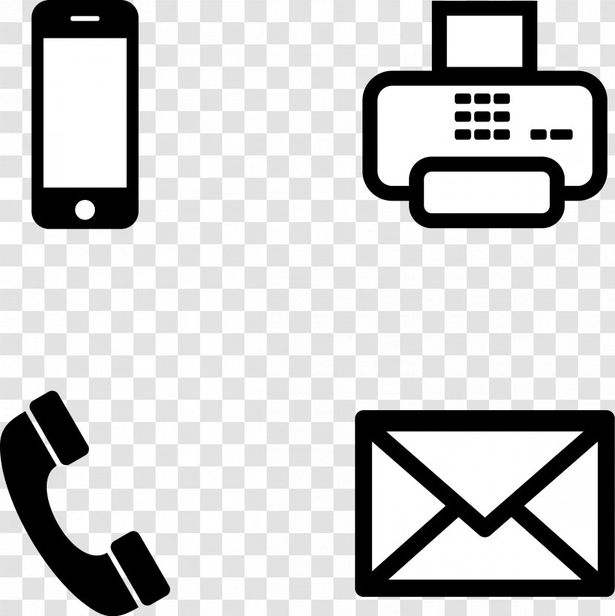
Index
Problem Statement
Process Model
Implementation Technology
Result
Advantages
Conclusion and Future Scope
References

Slide 3
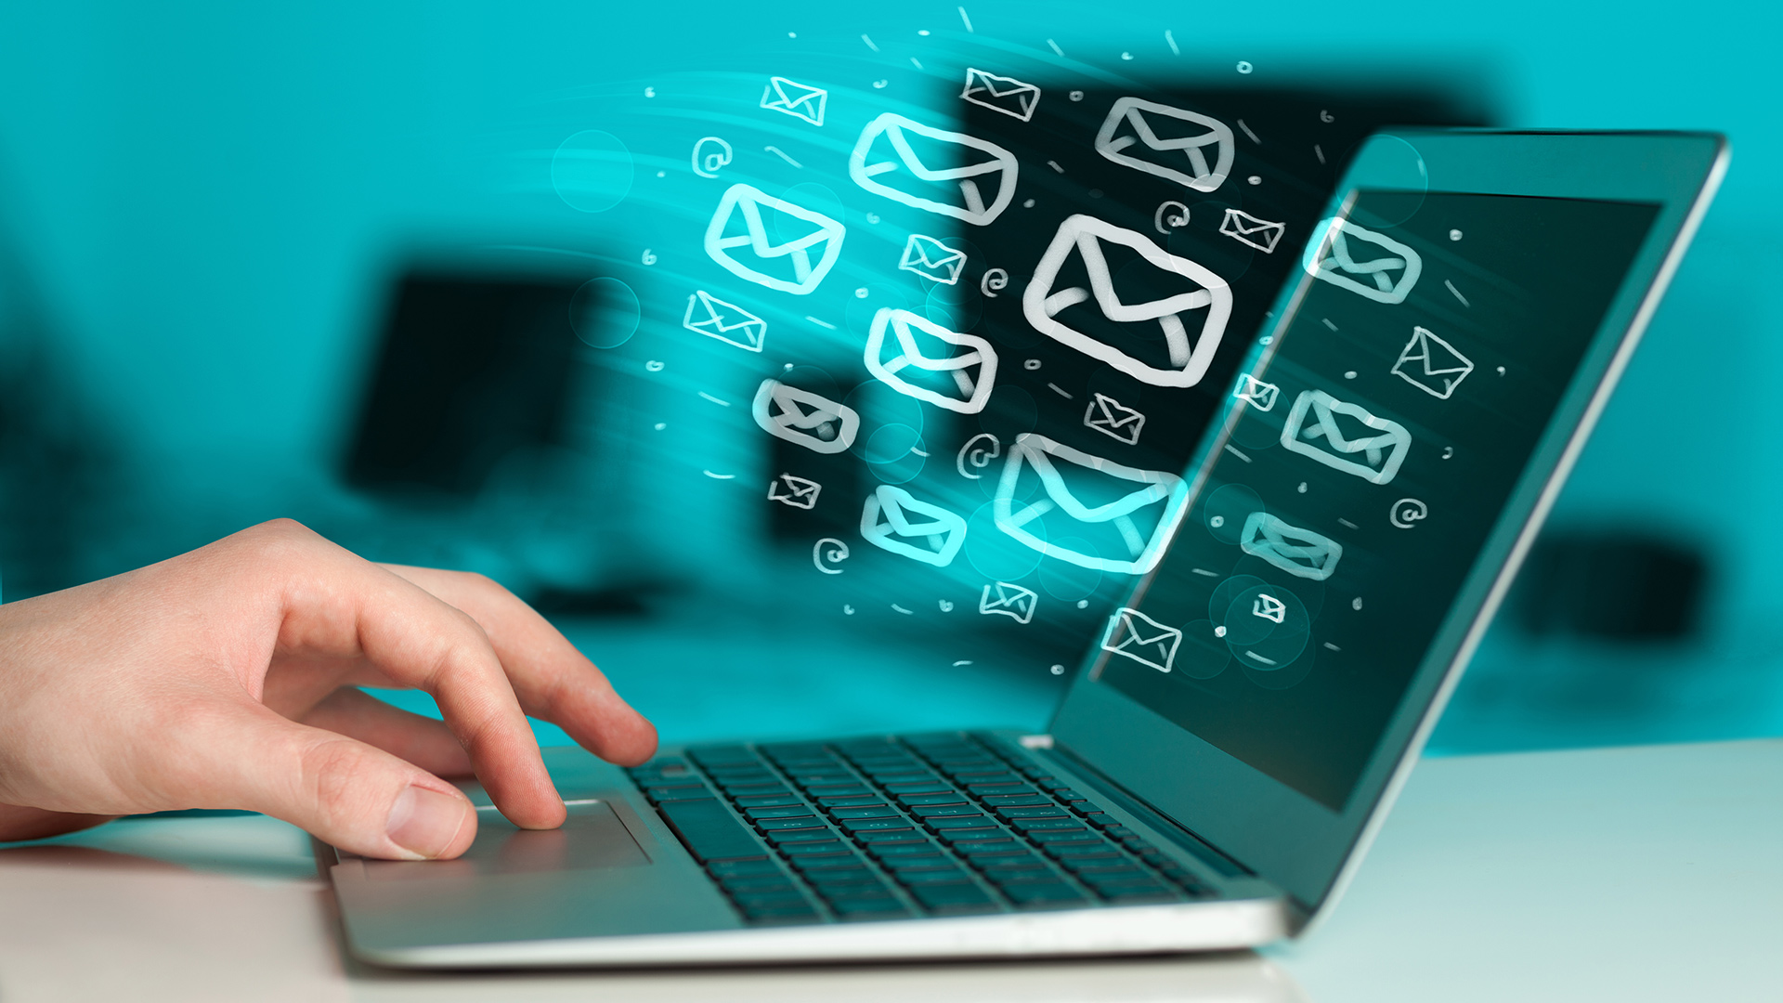
Problem statement
There are more than 250 million visually challenged people around the globe. That is, around 250 million people are unaware of how to use Internet or E-mail. The only way by which a visually impaired person can send an E-mail is, they have to dictate the entire content of the mail to a third person( not visually challenged ) and then the third person will compose the mail and send on the behalf of the visually impaired person.
But this is not a correct way to deal with this problem. It is very less likely that every time a visually challenged person can find someone for help. Although for these reasons the specially abled people are criticized by our society.
So, for the betterment of society and giving an equal status to such specially abled people we have come up with this project idea which provides the user with ability to send mails using voice commands without the need of keyboard or any other visual things.

Slide 4

Problem statement
The VOICE CONTROLLED EMAIL should be written in python, speech recognition system and the use of NLP in it. The system must provide a capacity for parallel operation and system design should not introduce scalability issues with regard to the number of surface computers, tablets or displays connected at any one time. The end system should also allow for seamless recovery, without data loss, from individual device failure.
This provides the user with ability to send mails using voice commands without the need of keyboard or any other visual things. We need the speech recognition , pip win and yagmail library to perform the audio commands in the system and to convert the speech into the text commands.

Slide 5

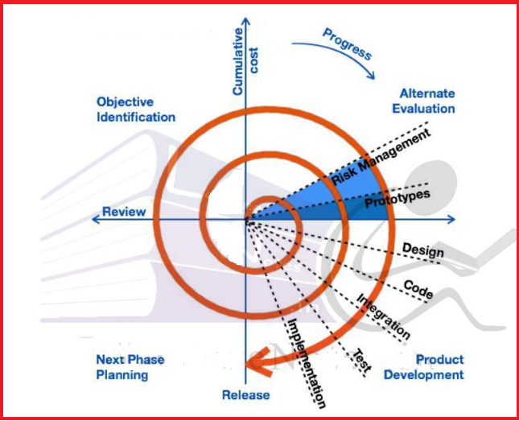


Process Model

Slide 6

Implementation Technology
Hardware Requirement:
RAM: 8 GB
ROM: 1 GB
Monitor with minimum screen resolution of 1024x768.
Software Requirement:
Windows 8 & above.
MacOS 8.0 & above.
Browsers:
Google Chrome, Mozilla Firefox, IE(Internet Explorer),
Microsoft Edge

Slide 7
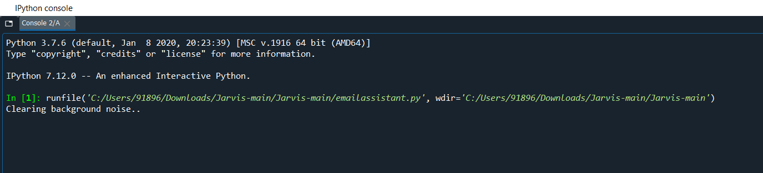
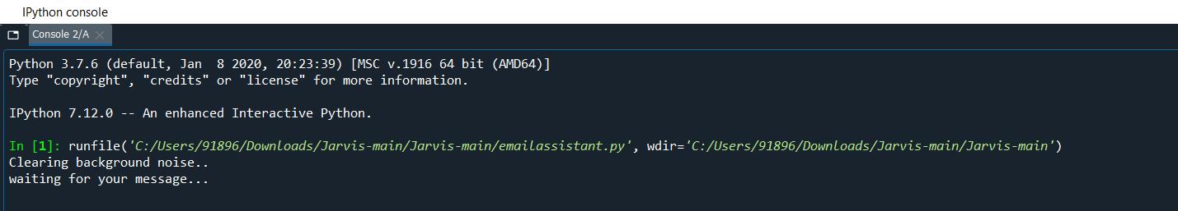
Big concept
RESULT
Bring the attention of your audience over a key concept using icons or illustrations

Slide 8
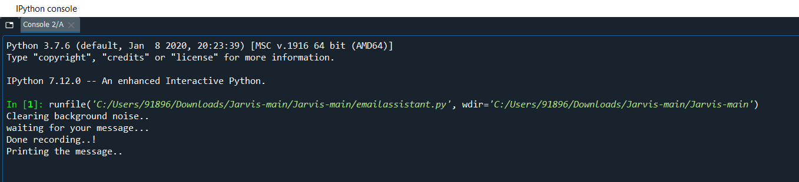
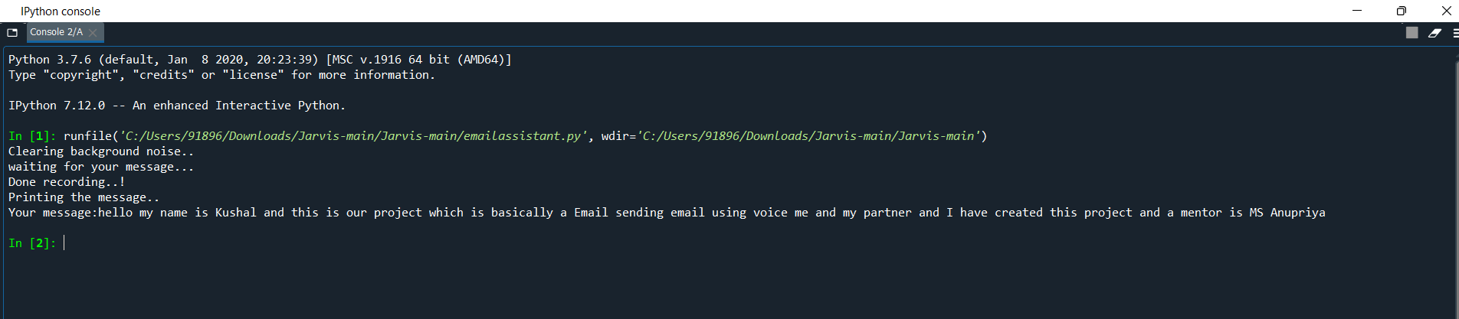
You can also split your content
White
Is the color of milk and fresh snow, the color produced by the combination of all the colors of the visible spectrum.
Black
Is the color of ebony and of outer space. It has been the symbolic color of elegance, solemnity and authority.

Slide 9
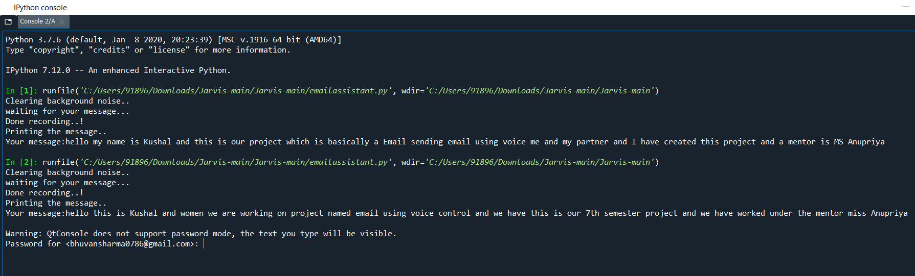
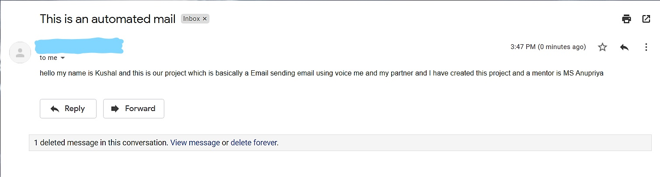
In two or three columns
Yellow
Is the color of gold, butter and ripe lemons. In the spectrum of visible light, yellow is found between green and orange.
Blue
Is the colour of the clear sky and the deep sea. It is located between violet and green on the optical spectrum.
Red
Is the color of blood, and because of this it has historically been associated with sacrifice, danger and courage.

Slide 10
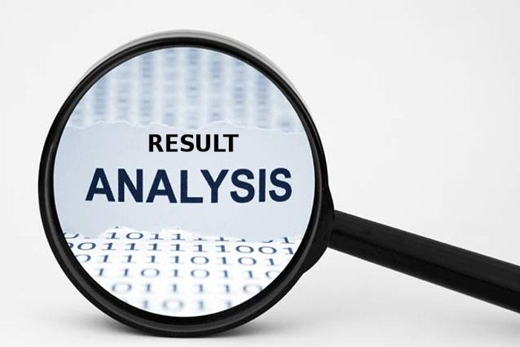
Analysis of Result
The application will be a web-based application for visually impaired persons using IVR- Interactive voice response, thus enabling everyone to control their mail accounts using their voice only and to be able to read ,send, and perform all the other useful tasks.
The system will prompt the user with voice commands to perform certain action and the user will respond to the same. The main benefit of this system is that the use of keyboard is completely eliminated, the user will have to respond through voice and mouse click only.

Slide 11

ADVANTAGES
This project is proposed for the betterment of society.
This project aims to help the visually impaired people to be a part of growing digital India by using internet and also aims to make life of such people quite easy.
This system makes the disabled people feel like a normal user.

Slide 12

ADVANTAGES
Also, the success of this project will also encourage developers to build something more useful for visually impaired or illiterate people, who also deserves an equal standard in society.
USE OF KEYBOARD for typing of Emails is completely removed.
User does not need to press the keys.

Slide 13

Conclusion & Future Scope
Thus, we can conclude that this system giving the accurate result. The inception of Internet has dramatically revolutionized many fields. Internet has made life of people so easy that people today have access to any information they want sitting at their home. One of the main fields that Internet has revolutionized is communication. And talking about communication over Internet, the first thing that comes in our mind is E-mail. E-mails are considered to be the most reliable way of communication over Internet, for sending or receiving some important information.
VOICE CONTROLLED EMAIL is a thing of the future which is yet to uncover its potential. Machine learning has changed the way companies were communicating with their customers. With new platforms to build various types of projects, it is of great excitement to witness the growth of a new domain in technology while surpassing the previous threshold.

Slide 14

REFERENCES
https://www.geeksforgeeks.org/project-idea-voice-based-email-visually-challenged/
https://cloud.google.com/speech-to-text/docs/quickstart
1
https://en.wikipedia.org/wiki/Speech_recognition
2
3
14

Slide 15

Thanks!
Any questions?

